Slide 1
Healthcare infrastructures develompment program in Alborz university of medical sciences (deputy of treatment)

Slide 2
introduction
Alborz province is the nearest province to the capital (30 km far from Tehran).
It is overcrowded and ranked eleventh in terms of population with 2.9 million people.
Because of proximity to the capital , good climate, tourist attraction (such as chalous road) and lots of industries, Alborz province ranked first in terms of immigration in the country.
Despite of numerous advantages as mentioned before , this large provinces deprived extremely in terms of healthcare infrastructure . for example it has lowest hospital bed index in the country (close to 0.7 bed per 1000 person).
Unfortunately in addition to the bed shortage, majority of buildings and medial equipments are worn outed and very old.
On the other hands there are a few general hospital in the province Thus because of the shortage of specialists and lack of equipments and facilities (such as MRI and CT SCAN) patients dispatch and referral system confront to many problems. Thus we need to renewing medical devices and reconstructing hospitals. Besides we have to build new constructions to increase hospital bed index and improve health care standards.

Slide 3
ALBORZ PROVINCE MAP
TALEGHAN
MAZANDRAN. P
QAZVIN. P
SAVOJBOLAGH
KARAJ
NAZARABAD
FARDIS
ESHTEHARD
TEHRAN. P
TEHRAN. P
MARKAZI. P

Slide 4
Personel statistics
Specialists | 1270
GP | 2306
Dentlsts | 1001
Medical centers (current year)
pharmacy | 367
laboratory | 157
Imaging center | 101
GP office | 1146
Specialists office | 746
Dentists office | 863

Slide 5
Some of the features of Alborz province
The Largest host province with the most immigrants in the country.
One of the biggest provinces ranked eleventh in terms of population (more than 2.9 million persons).
By about 18 percent of all country road traffic is allocated to alborz province.
The average annual growth rate of population is 3/04
3.3 percent of the total population of country live in Alborz province.
Population density of 471 persons per square km.
It has more than 80,000 foreigners (nearly 3.3 percent of population).

Slide 6
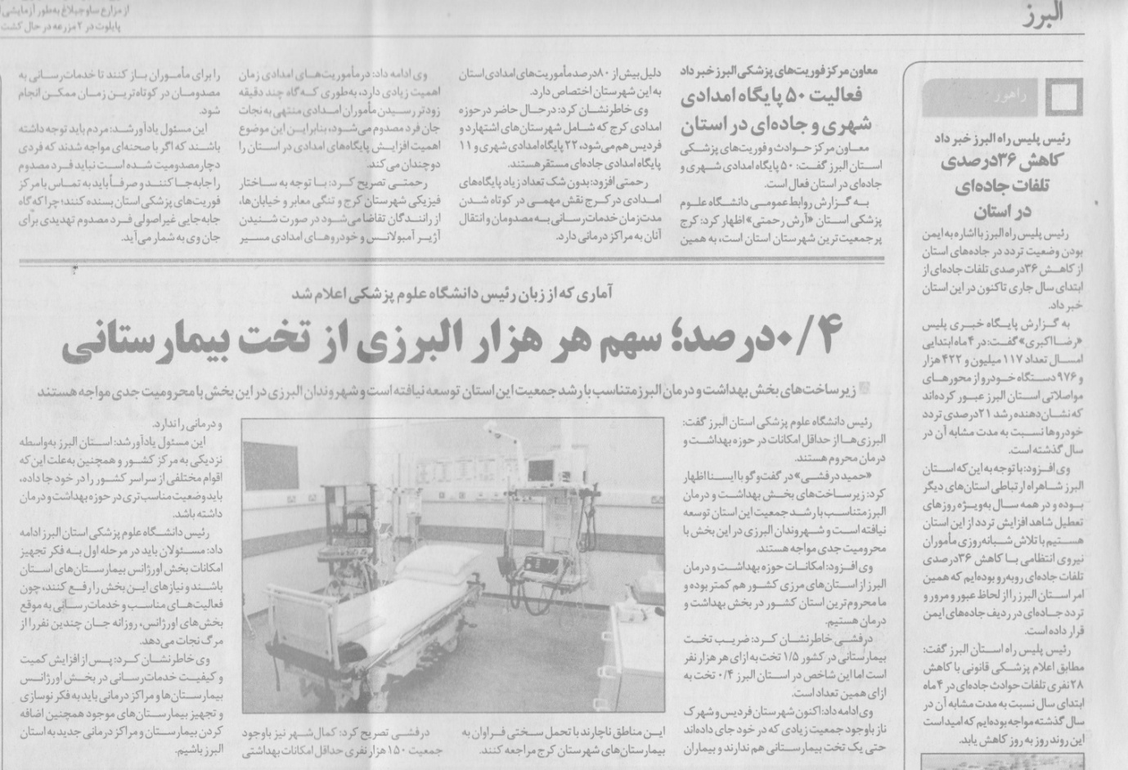
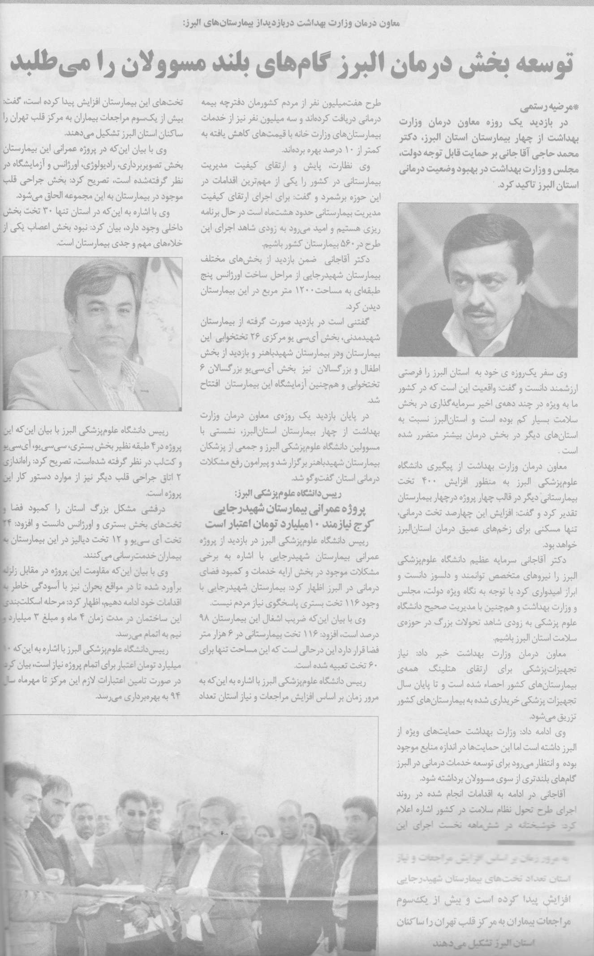
Dean of Alborz medical university said:
Healthcare development of Alborz needs officials strides.

Slide 7
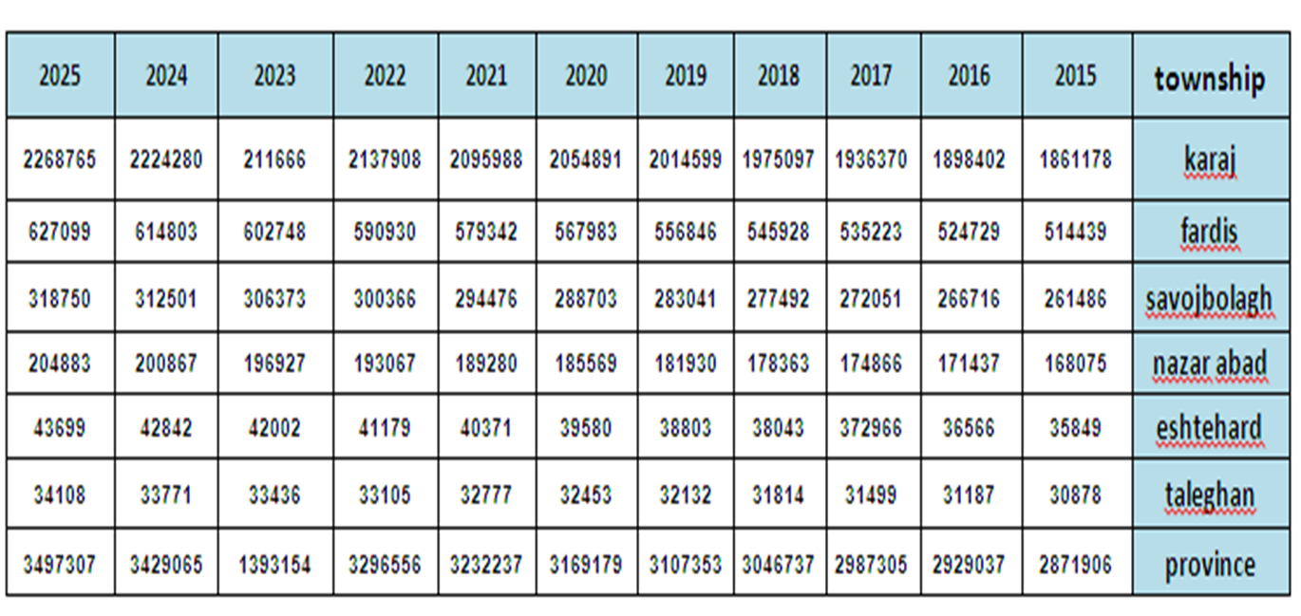
Demographic profile of province (10 year horizon) from 2015 to 2025
NOTE:
- Teleghan is more than 100km far from the center.
- Eshtehard is more than 70 km far from the center.

Slide 8
Specifications of hospitals ( 2015- 2016 )
TYPE OF PRIORITY | EDU OR NON-EDU | Private or Governmental | ACTIVE (USED) BEDS | TOWNSHIP | HOSPITAL
SURGICAL | EDU | G | 328 | karaj | Shahid Madani
GENERAL | NON-EDU | G | 99 | karaj | DR. shariati
OBESTETRIC | EDU | G | 136 | karaj | Kamali
OBESTETRIC | NON-EDU | G | 31 | karaj | Imam Ali
PEDIATRIC | EDU | G | 216 | karaj | Shahid Bahonar
CARDIOLOGIC | EDU | G | 120 | karaj | Shahid Rajaee
GENERAL | NON-EDU | G | 38 | karaj | sarallah
GENERAL | NON-EDU | G | 156 | karaj | Kausar
GENERAL | NON-EDU | G | 345 | karaj | Alborz
GENERAL | NON-EDU | P | 211 | karaj | Ghaem
GENERAL | NON-EDU | P | 70 | karaj | Kasra
GENERAL | NON-EDU | P | 142 | karaj | Imam khomeini
OBESTETRIC | NON-EDU | P | 34 | karaj | Maryam
GENERAL | NON-EDU | P | 144 | karaj | Takhte jamshid
GENERAL | EDU | G | 74 | Savojbolagh | Imam jafar
GENERAL | NON-EDU | G | 64 | Nazar abad | Imam hassan
GENERAL | NON-EDU | G | 22 | Eshtehard | Zahra
- |  |  | 2230 | Total

Slide 9
Operational indicators of hospitals in Alborz province
(first semester of current year)
Index hospital |  | Used beds | outpatienal visit s | Admissions | Percentage of occupay | Averange stay | Perception per bed | Total surjery | Referrals to emergency | Referrals to paraclinic
Township | Hospital
karaj | Shahid Madani | 258 | 84578 | 8163 | 89/26 | 4/1 | 39/8 | 13154 | 59027 | 91926
 | DR. shariati | 99 | 85754 | 3764 | 76/88 | 3/1 | 47/1 | 5639 | 53325 | 53398
 | Kamali | 136 | 74727 | 13856 | 121/89 | 2/2 | 101/9 | 6657 | 55208 | 97271
 | Imam Ali | 31 | 11472 | 1926 | 41/76 | 1/3 | 62/1 | 1044 | 4555 | 8868
 | Shahid Bahonar | 216 | 149504 | 8334 | 83/65 | 3/9 | 40/1 | 3210 | 118688 | 81754
 | Shahid Rajaee | 120 | 65636 | 4929 | 100/93 | 4/5 | 41/1 | 1035 | 42686 | 125897
 | sarallah | 38 | 79089 | 2534 | 66/86 | 1/9 | 66/7 | 1895 | 56093 | 38032
 | Kausar | 156 | - | - | - | - | - | - | - | -
 | Alborz | 345 | 254960 | 21707 | 80/77 | 2/4 | 62/9 | 10460 | 94438 | 210147
 | Ghaem | 211 | 35533 | 7966 | 53/79 | 2/7 | 37/8 | 4325 | 22930 | 92118
 | Kasra | 70 | 28357 | 5620 | 67/78 | 1/6 | 80/3 | 5246 | 24148 | 58215
 | Imam khomeini | 142 | 55820 | 6834 | 71/26 | 2/6 | 50 | 4535 | 27190 | 74944
 | Maryam | 34 | 7326 | 1511 | 47/34 | 2 | 44/4 | 979 | 3338 | 13064
 | Takhte jamshid | 144 | 25949 | 6887 | 72/63 | 2/1 | 62/8 | 4905 | 12776 | 62272
savojbolagh | Imam jafar | 74 | 71851 | 3452 | 82/96 | 2/9 | 53/9 | 2930 | 44515 | 49358
nazar abad | Imam hassan | 64 | 104880 | 3278 | 78/42 | 2/9 | 51/2 | 2116 | 48336 | 39434
eshtehard | Zahra | 22 | 46730 | 781 | 33/41 | 1/6 | 35/5 | 864 | 30267 | 17575
Total |  | 2004 | 1182166 | 101535 | 81/33 | 2/6 | 58/2 | 68994 | 697520 | 1114373

Slide 10
Accomplished projects (current year)
Hospital | Activated beds
Shahid Madani | 130
Kausar | 156
Other hospitals | 83
Total | 369
Ongoing projects (next year)
Hospital | Beds
Shahid Rajaee | 150
Kamali | 200
Shahid Bahonar | 220
Imam Hossein | 100
sarallah | 75
Total | 745

Slide 11
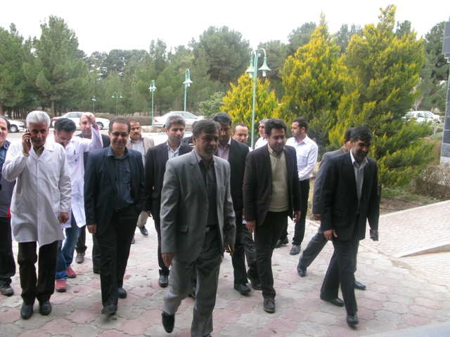
KAUSAR HOSPITAL
(156 HOSPITAL BEDS)

Slide 12
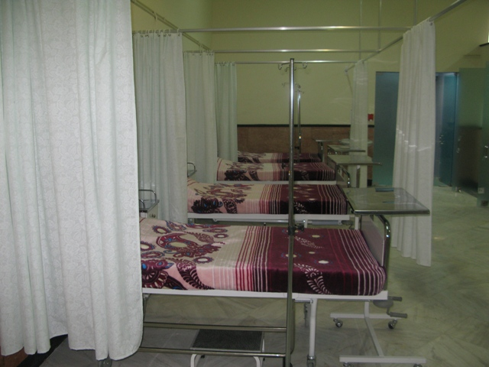
KAUSAR HOSPITAL
(THE BIGGEST ONCOLOGY AND CHEMOTHERAPY CENTER IN THE PROVINCE)

Slide 13
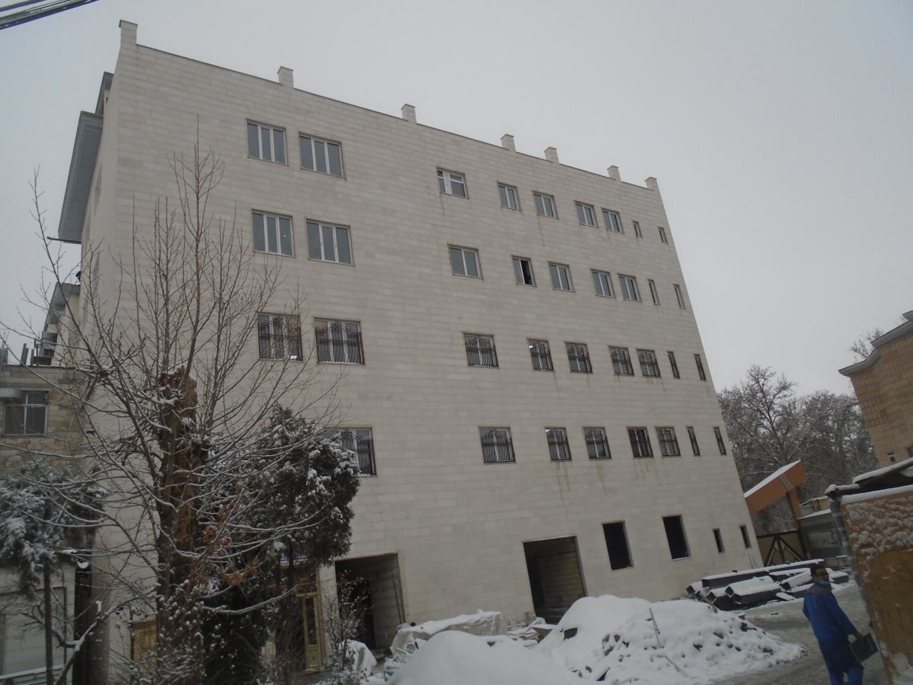
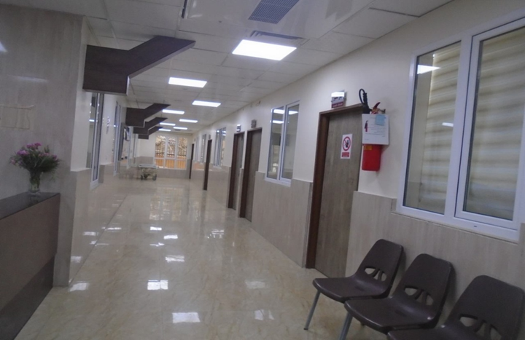
SHAHID MADANI HOSPITAL
(130 BEDS PROJECT WITH 5500 SQUARE METERS – ICU AND SURGICAL DEPARTMENTS)

Slide 14
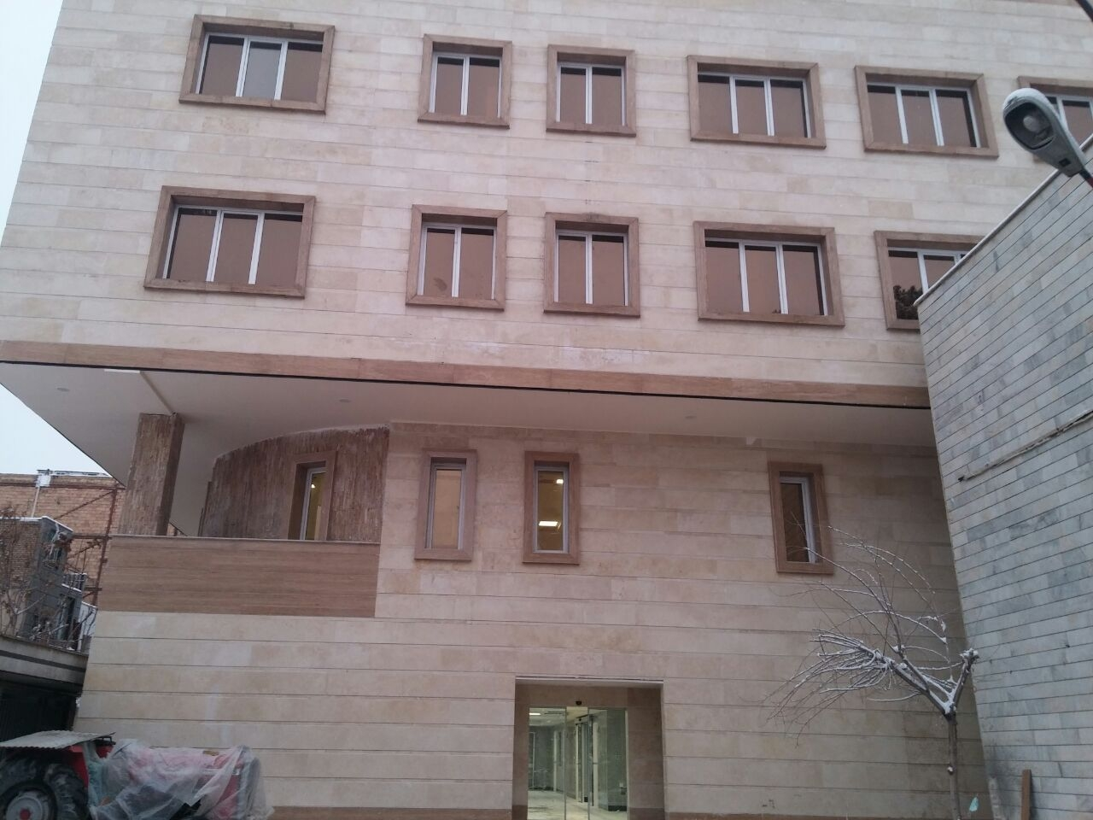
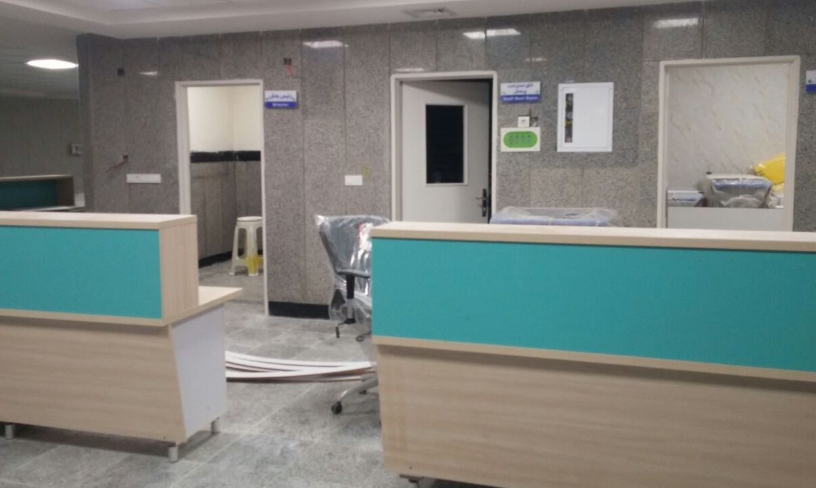
SHAHID RAJAEE HOSPITAL
(150 BEDS PROJECT WITH 8000 SQUARE METERS – ICU, EMERGENCY, HEART AND POISONING DEPArTMENTS)

Slide 15
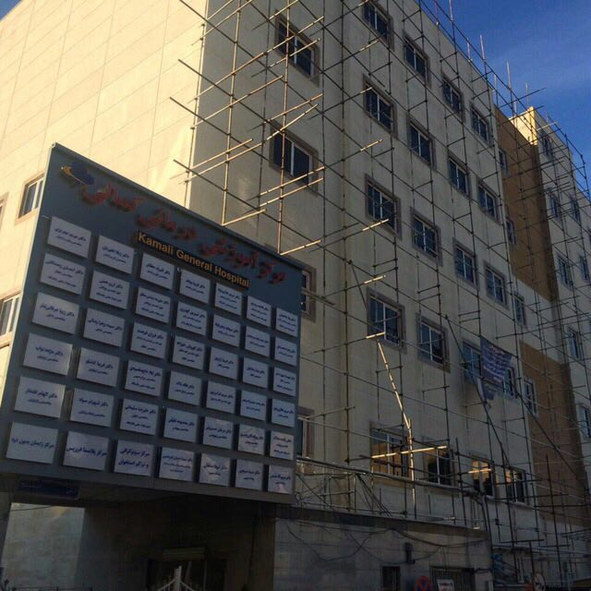
KAMALI HOSPITAL
(200 BEDS PROJECT WITH 6600 SQUARE METERS – ICU, NICU, PICU, LDR, NEONATSL, OBESTETRIC AND EMERGENCY DEPARTMENTS)

Slide 16
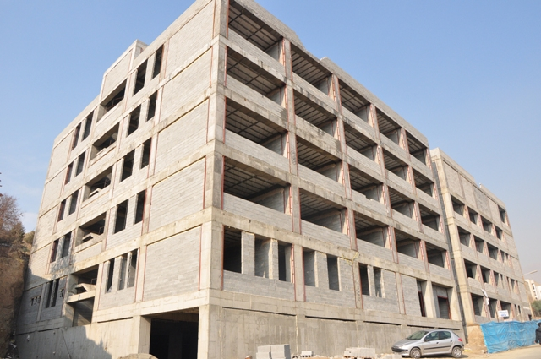
SHAHID BAHONAR HOSPITAL
(220 BEDS PROJECT WITH 12000 SQUARE METERS – PEDIATRIC, OBSTETRIC AND DEPARTMENTS)

Slide 17
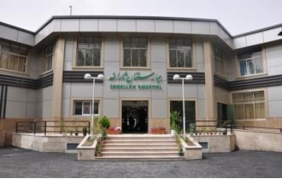
SARALLAH HOSPITAL
(75 BEDS PROJECT WITH 6000 SQUARE METERS – CCU, ICU, PEDIATRIC, OBESTETRIC, OPHTHALMOTOGIC, INTERNAL AND SURGICAL DEPARTMENTS)

Slide 18
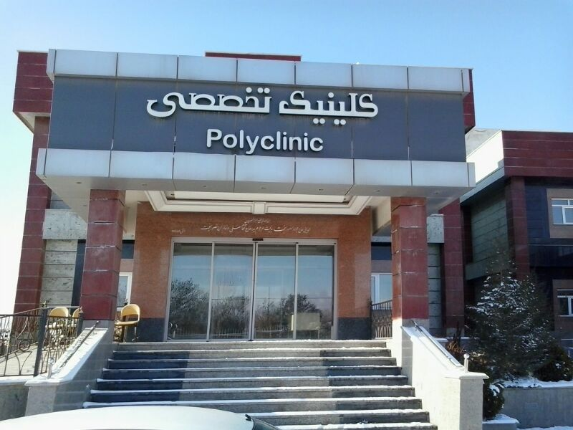
IMAM HOSSEIN HOSPITAL
(100BEDS PROJECT– PSYSHOLOGIC CENTER OF THE PROVINCE)

Slide 19
COMPArative TABLE OF HOSPITAL BEDS IN ALBORZ PROVINCE
TOWNSHIP | ACTIVE (USED) BEDS
 | 93 | first semester of current year
Karaj | 1711 | 2070
Savojbolagh | 64 | 74
Nazar abad | 64 | 64
Eshtehard | 22 | 22
Taleghan | 0 | 0
Fardis | 0 | 0
PROVINCE | 1861 | 2230

Slide 20
SITUATION OF THE PROVINCE HASPITAL BED INDEX
(ON THE 5 YEAR HORIZON)
YEAR | POPULATION | USED BEDS | BED INDEX | AIM INDEX | BED NEEDED | BED SHORTAGE
Iast year | 2808536 | 1861 | 66% | 1/5 | 4212 | 2351
Current year | 2871906 | 2230 | 77% | 1/5 | 4306 | 2076
One year later | 2929037 | 2975 | 1 | 1/7 | 4979 | 2004
five year later | 3169179 | - | - | 2/5 | 7922 | -
It should be noted that with implementation of the projects 745 beds will be added to the hospital bed capacity. But most people of some township such as Malard and Marlik from adjacent province (Tehran) refer to Alborz. Thus the target population of the province approximately will be million people. Thus beds will be needed years later.

Slide 21
GOVERNMENTAL RADIOLOGIC AND IMAGING CENTERS
EQUIPMENTS | PRESENT | NEEDED
CT SCAN | 4 | 3
angiography | 1 | 3
NUCLEAR MEDICIN (GAMMA SCANE) | 1 | 3
RadioTHERAPY | 0 | 2
MRI | 0 | 4
PET SCAN | 0 | 1
BRACHY THERAPY | 0 | 1
GAMA KNIFE | 0 | 1
CYBER KNIFE | 0 | 1

